Slide 1
Configuring Internet Access for a Network

Slide 2
Overview
Options for Connecting a Network to the Internet
Configuring Internet Access by Using a Router
Configuring Internet Access by Using NAT

Slide 3
Options for Connecting a Network to the Internet
Connecting to the Internet by Using a Router
Securing Internet Connections by Using a Firewall
Connecting to the Internet by Using NAT
Connecting to the Internet by Using Internet Connection Sharing
Connecting to the Internet by Using a Proxy Server
Comparing Internet Connectivity Options

Slide 4







Connecting to the Internet by Using a Router
Connecting Your Network to the Internet by Using a Router:
  Optimizes network performance
  Enables all users in your network to share a single connection to the Internet
  Is the easiest method for connecting your network to the Internet
Intranet
Internet
Router

Slide 5
Securing Internet Connections by Using a Firewall
Securing Internet Connections by Using a Firewall:
  Prevents unauthorized access to your network
  Enables you to specify the type of traffic that is allowed into and out of your network
Firewall
Intranet
Internet
Router

Slide 6







Connecting to the Internet by Using NAT
Client Computers
Internet
Computer Running NAT
Internal IP = 192.168.1.1
External IP = 131.107.2.1
IP = 192.168.1.3
Web Server
IP = 131.107.50.1
IP = 192.168.1.4
The client sends the packet to the computer running NAT
The computer running NAT changes the packet header and sends the packet over the Internet to the Web server
The Web server sends a reply to the computer running NAT
IP = 192.168.1.5
The computer running NAT determines the destination, changes the packet header, and sends the packet to the client

Slide 7
Connecting to the Internet by Using Internet Connection Sharing
Connecting to the Internet by Using Internet Connection Sharing:
  Simplifies the process of configuring NAT
  Enables small-office and home-office networks to share a single connection to the Internet
Small-Office or Home-Office Network
Internet
Internet Connection Sharing

Slide 8
Connecting to the Internet by Using a Proxy Server
Connecting to the Internet by Using a Proxy Server:
  Provides security by acting as a gateway between your network and the Internet
  Caches information to reduce traffic between your intranet and the Internet
LAN
Internet
Proxy Server

Slide 9
Comparing Internet Connectivity Options
Comparing Internet Connectivity Options
NAT vs. Routing
NAT vs. Proxy Server
Internet Connection Sharing vs. NAT

Slide 10
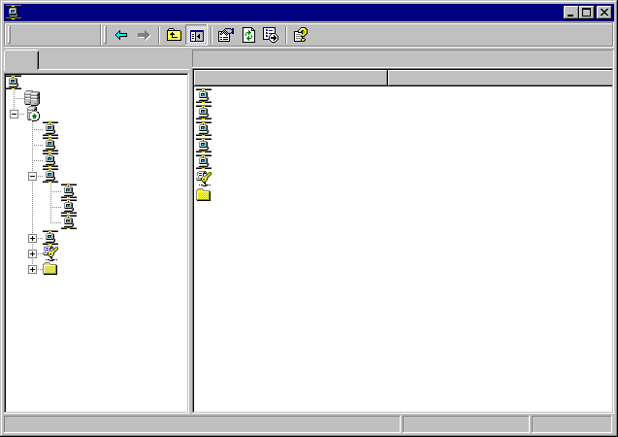

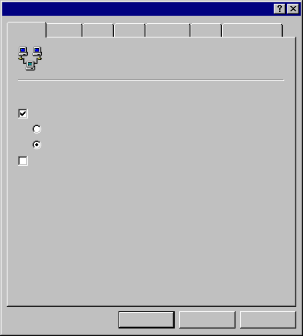
Configuring Internet Access by Using a Router
Routing and Remote Access
Action
View
LONDON (local) Properties
Tree
LONDON (local)
General
Security
IP
IPX
AppleTalk
PPP
Event Logging
Routing and Remote Access
Name
Server Status
Routing Interfaces
Routing and Remote Access
LONDON (local)
Ports
Routing Interfaces
AppleTalk Routing
Ports
IP Routing
Enable this computer as a:
AppleTalk Routing
IPX Routing
IP Routing
Router
Remote Access Policies
General
Remote Access Logging
Local area network (LAN) routing only
Static Routes
LAN and demand-dial routing
IGMP
IPX Routing
Remote access server
Remote Access Policies
Remote Access Logging
OK
Cancel
Apply

Slide 11
Configuring Internet Access by Using NAT
Installing NAT
Configuring NAT
Installing the Router Interface for NAT

Slide 12
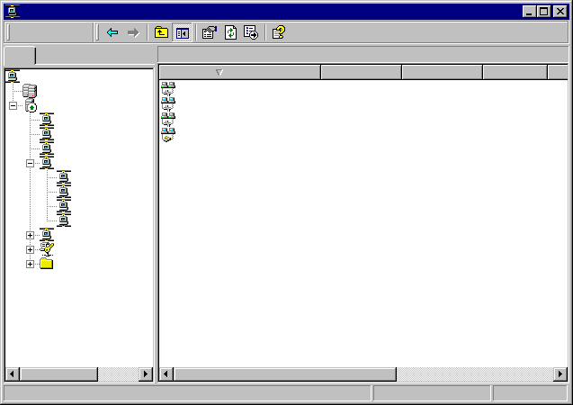
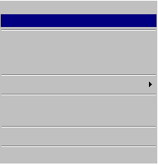
Installing NAT
Routing and Remote Access
Action
View
Tree
General
Routing and Remote Access
Interface
Type
IP Address
Administr…
Op
Server Status
Loopback Loopback 127.0.0.1 Up Op
LONDON (local)
Local Area Connector Dedicated 192.168.1.200 Up Op
Routing Interfaces
Internal Internal Not available Unknown No
Ports
Test_demanddial Demand-dial Not available UP Dis
AppleTalk Routing
IP Routing
General
Static Routes
New Interface…
IGMP
New Routing Protocol…
Networking
Show TCP/IP Information
Show Multicast Forwarding Table…
Show Multicast Statistics
IPX Routing
Remote Access Policies
Remote Access Logging
View
Refresh
Export List…
Properties
Help

Slide 13
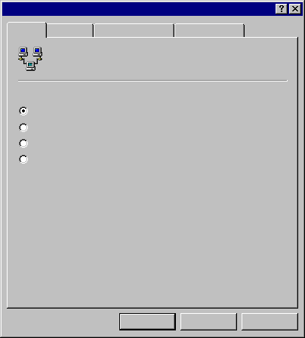
Configuring NAT
Network Address Translation (NAT) Properties
General
Translation
Address Assignment
Name Resolution
Network Address Translation (NAT) Global
Event logging:
Log errors only
Log errors and warnings
Log the maximum amount of information
Disable event logging
OK
Cancel
Apply

Slide 14
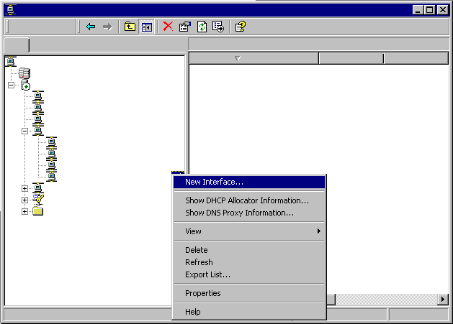

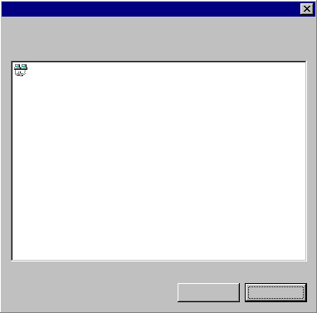
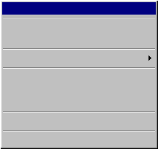
Installing the Router Interface for NAT
Routing and Remote Access
Action
View
Tree
Network Address Translation (NAT)
Routing and Remote Access
Interface
Total mappings
Inbound pack…
Server Status
LONDON (local)
Routing Interfaces
Ports
New Interface for Network Address Translation (NAT)
AppleTalk Routing
This routing protocol runs on the interface that you select below
IP Routing
General
Interfaces:
Static Routes
Local Area Connection
IGMP
Network Address Translation (NAT)
IPX Routing
New Interface…
Remote Access Policies
Show DHCP Allocator Information
Show DNS Proxy Information…
Remote Access Logging
View
Delete
Refresh
Export List…
Properties
Help
OK
Cancel

Slide 15
Review
Options for Connecting a Network to the Internet
Configuring Internet Access by Using a Router
Configuring Internet Access by Using NAT

Slide 16
Configuring a Web Server

Slide 17
Overview
Overview of IIS
Preparing for an IIS Installation
Installing IIS
Configuring a Web Site
Administering IIS
Troubleshooting IIS

Slide 18


Overview of IIS
~~~ ~~~ ~~~
~~~ ~~~ ~~~
~~~ ~~~ ~~~
SERVER
Intranet
Internet
A Windows 2000 /2003 Server Running IIS Provides:
World Wide Web (WWW) Server
File Transfer Protocol (FTP) Service
Network News Transfer Protocol (NNTP) Service
Simple Mail Transfer Protocol (SMTP) Service

Slide 19





Preparing for an IIS Installation
Install TCP/IP
Configure a Static IP Address
192.168.120.133
Establish a Domain Name
nwtraders.msft
Configure NTFS
NTFS

Slide 20
Installing IIS
To Install IIS
Perform the Installation:
Add Internet Services Manager to the
Administrative Tools Menu
Create the Default Web Site and the
Default FTP Site
Test the Installation:
Use Internet Explorer to View Files in
the Home Directory, C:\inetpub\wwwroot

Slide 21
Configuring a Web Site
Configuring Web Site Identification
Configuring the Home Directory
Identifying Methods of Authentication
Selecting a Method of Authentication
Configuring Authentication
Assigning a Default Document

Slide 22
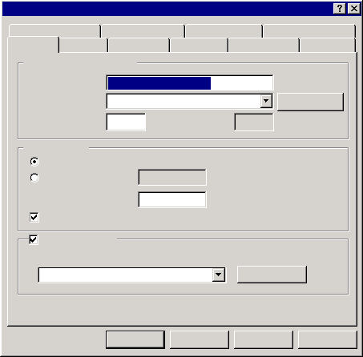
Configuring Web Site Identification
Default Web Site Properties
Directory Security
HTTP Headers
Custom Errors
Server Extensions
Web Site
Operators
Performance
ISAPI Filters
Home Directory
Documents
Web Site Identification
Description:
Default Web Site
IP Address:
(All Unassigned)
Advanced...
TCP Port:
80
SSL Port:
Connections
Unlimited
Limited To:
1000
connections
Connection Timeout:
900
seconds
HTTP Keep-Alives Enabled
Enable Logging
Active log format:
W3C Extended Log File Format
Properties...
OK
Cancel
Apply
Help

Slide 23
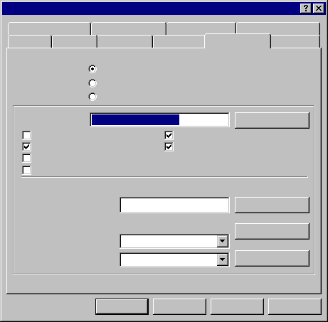
Configuring the Home Directory
Default Web Site Properties
Directory Security
HTTP Headers
Custom Errors
Server Extensions
Web Site
Operators
Performance
ISAPI Filters
Home Directory
Documents
When connecting to this resource, the content should come from:
Directory on
local computer
A directory located on this computer
A share located on another computer
A redirection to a URL
Shared folder
Local Path:
C:\inetpub\wwwroot
Browse...
Script source access
Read
Write
Directory browsing
Log visits
Index this resource
Application Settings
Application name:
Default Application
Remove
Starting point:
<Default Web Site>
Configuration...
Execute Permissions:
None
Application Protection:
Medium (Pooled)
Unload
OK
Cancel
Apply
Help

Slide 24
Identifying Methods of Authentication
Anonymous Access
Basic Authentication
Digest Authentication
Integrated Windows Authentication

Slide 25
Selecting a Method of Authentication
Authentication
Method
Use When
Anonymous
You want users to access public areas of your
web site
Basic
You want to authenticate users who access your web site through any browser or proxy server
Digest
You want to secure authentication for your web sites and you must go through a proxy server
Integrated Windows
You are configuring an intranet site, where both the users and the web server are in the same domain, or in domains with a trust relationship

Slide 26
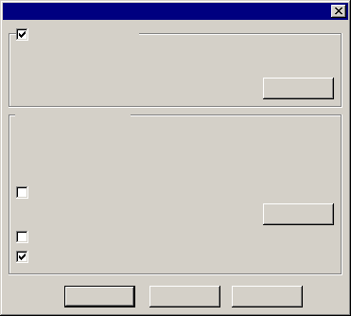
Configuring Authentication
Authentication Methods
Anonymous
Access
Anonymous access
No user name/password required to access this resource.
Account used for anonymous access:
Edit…
Authenticated access
For the following authentication methods, user name and
password are required when:
- anonymous access is disabled, or
- access is restricted using NTFS access control lists
Basic
Authentication
Basic authentication (password is sent in clear text)
Select a default domain
Edit…
Digest
Authentication
Digest authentication for Windows domain servers
Integrated Windows
Authentication
Integrated Windows authentication
OK
Cancel
Help

Slide 27
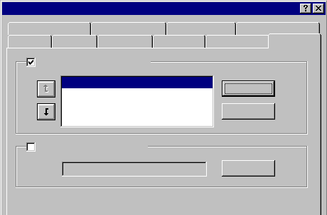
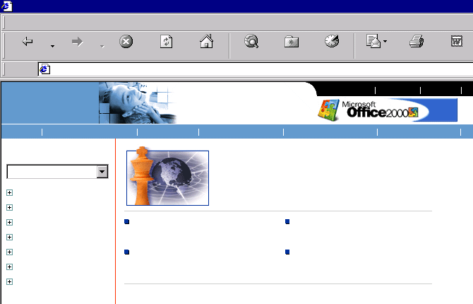
Assigning a Default Document
Default Web Site Properties
Directory Security
HTTP Headers
Custom Errors
Server Extensions
Web Site
Operators
Performance
ISAPI Filters
Home Directory
Documents
Enable Default Document
Default.htm
Add...
Default.asp
iisstart.asp
Welcome to Microsoft’s Homepage - Microsoft Internet Explorer
File Edit View Favorites Tools Help
Remove
Back
Forward
Stop
Refresh
Home
Search
Favorites
History
Mail
Print
Edit
Enable Document Folder
http://www.microsoft.com/ms.htm
microsoft.com
Home
Browse...
Home
Events & Training
Subscribe
About Microsoft
U.S. & International
About Our Site
See page customized for:
Are You Ready to Take on the Chess Master?
All
Product Families
Business Customers
Developers
Education
Home User
IP Professionals
Partners & Resellers
Find Out What’s Happening at
PC Expo in New York
Enter to Win a Gateway PC Loaded
with Office 2000
Rick Rashid: The Steady Hand
Behind Microsoft Research
Download Outlook Updates for the
E-mail Attachments Virus

Slide 28
Administering IIS
Use Internet Services Manager to Manage Web Servers Remotely
Use System Monitor to Monitor IIS Performance

Slide 29
Troubleshooting IIS
Testing a Web Site Connected to the Internet
Testing a Web Site on Your Intranet
Resolving IIS Problems

Slide 30
Lab A: Configuring a Web Server

Slide 31
Review
Overview of IIS
Preparing for an IIS Installation
Installing IIS
Configuring a Web Site
Administering IIS
Troubleshooting IIS

